Slide 1
Introduction

Slide 2
Data

Slide 4


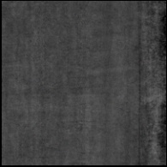
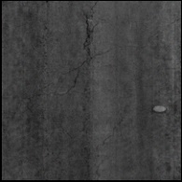
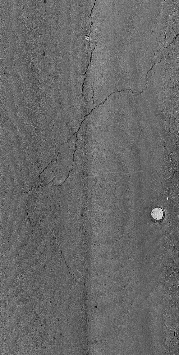
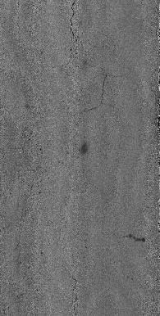

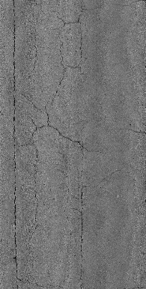
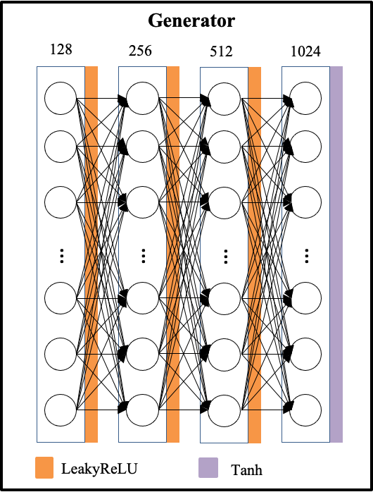
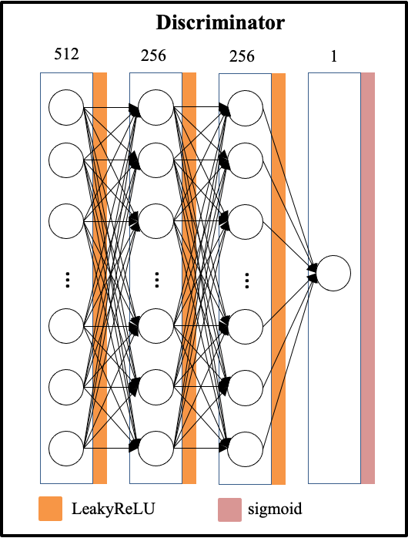
Discriminator
Generator
512
128
LeakyReLU
LeakyReLU
256
256
LeakyReLU
LeakyReLU
256
512
LeakyReLU
LeakyReLU
1
1024
Sigmoid
Tanh

Slide 5
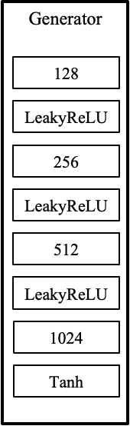
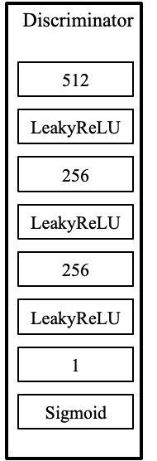
Random input vector
Update model
Fake images
Real/fake
Real images
Update model

Slide 6
Random input vector
Fake images
Update
model
Real images
Real/fake
Update model

Slide 7
Random input vector
Fake images
Update
model
Real images
Real/fake
Update model

Slide 8
Random input vector
Generator
Update model
Fake images
Discriminator
Real/fake
Real images
Update model

Slide 9
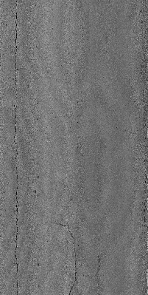
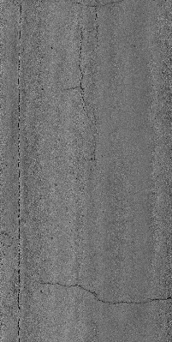
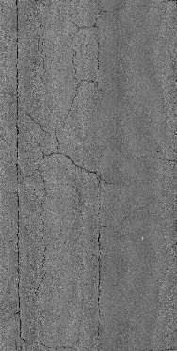
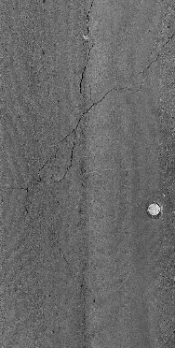
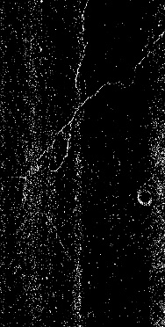
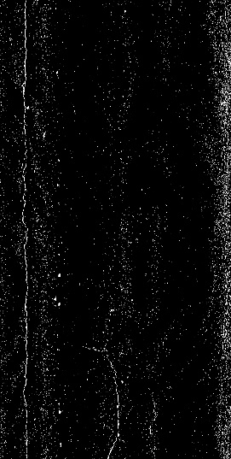
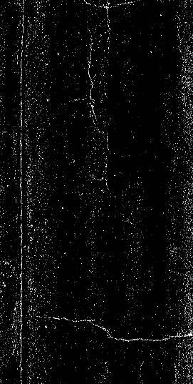
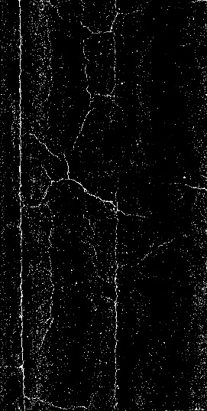
1
6
7
8

Slide 10
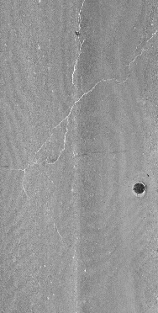
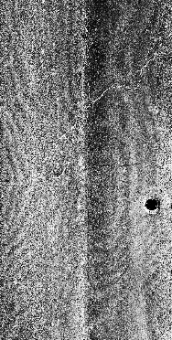
(a)
(b)
(c)
(d)

Slide 11
Pavement images
GAN
Annotation
Training
Validation
Yolov5
Testing

Slide 12
Pavement images
Preprocess
Training
Yolov5
Testing
GAN
Annotation
Validation
Organizer
Team

Slide 13
Pavement images
Training
Yolov5
Testing
GAN
Annotation
Validation

Slide 14
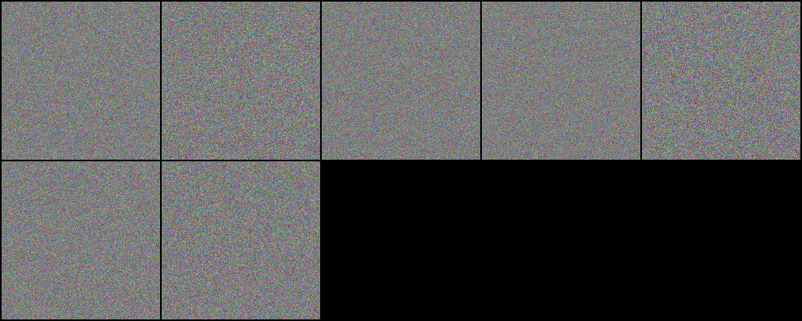
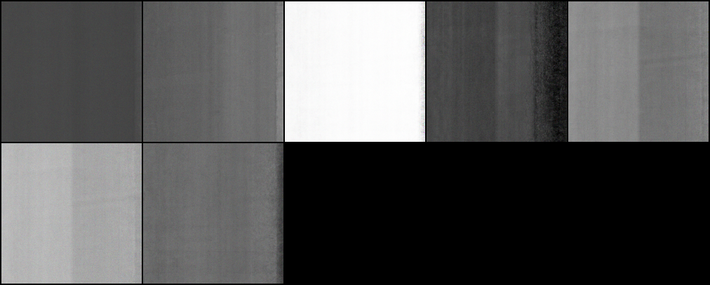

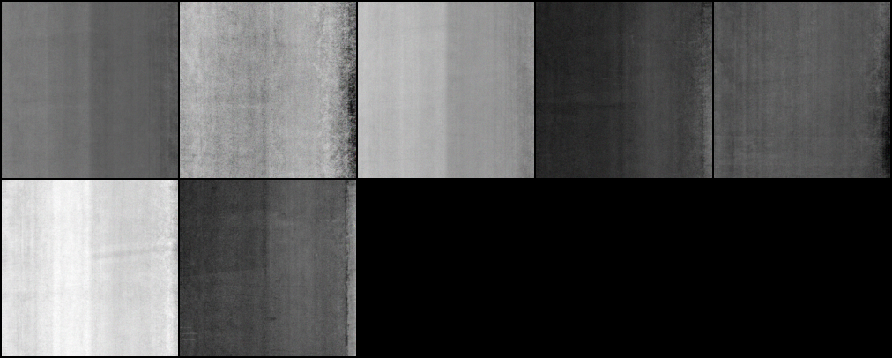
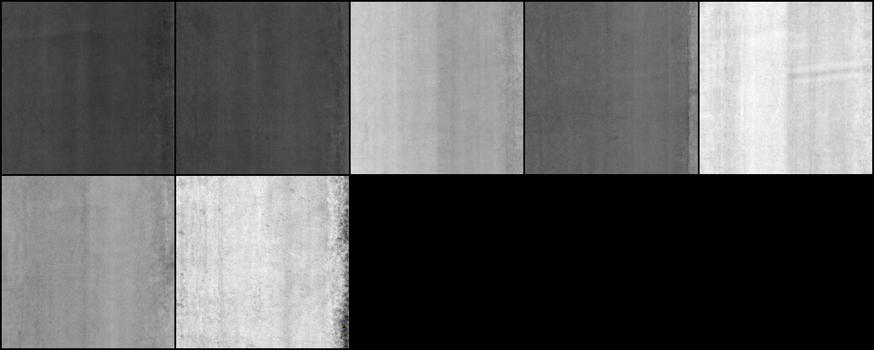
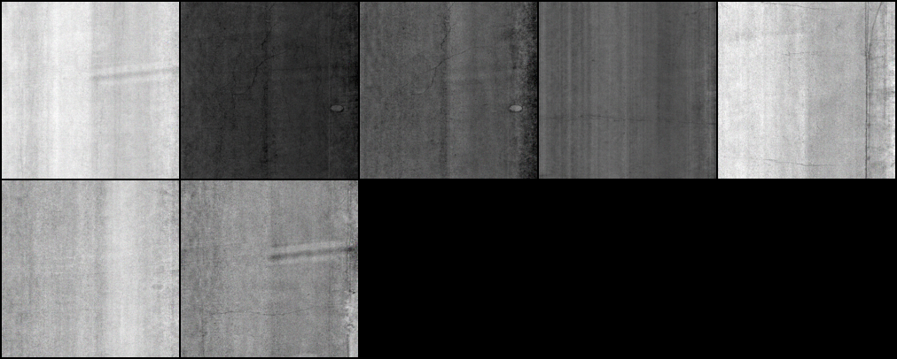
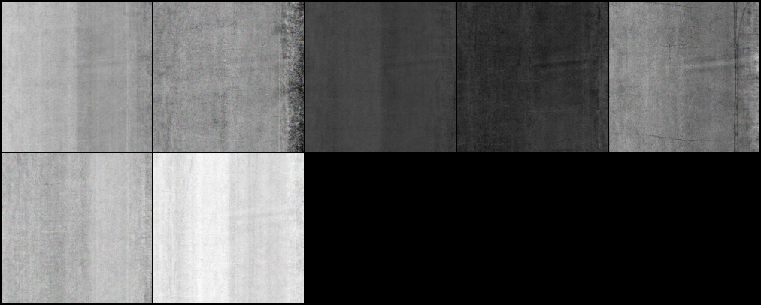
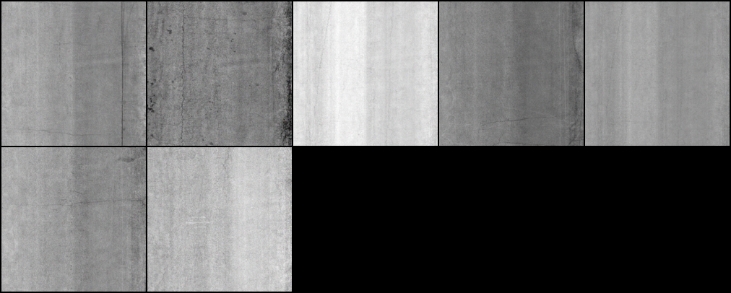
0
20000
40000
60000
80000
100000
120000
140000

Slide 15
Input Layer
LeakyReLU
Tanh
…
…
…
…
128
256
512
1024

Slide 16
Input Layer
Hidden Layer
…
…
…
…
128
256
512
1024

Slide 17
Generator
128
256
512
1024
…
…
…
…
LeakyReLU
Tanh

Slide 18
Discriminator
512
256
256
…
…
…
LeakyReLU

Slide 19
Generator
128
256
512
1024
…
…
…
…
LeakyReLU
Tanh

